Slide 1
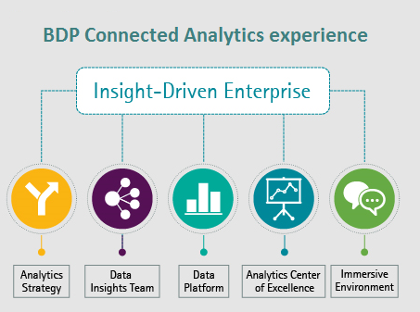
OFFICIAL USE ONLY
BDP : Vision
Vision : DOE-BDP platform will provide a centralized data lake solutions with an ability to aggregate a variety of real-time and predictive data analytics.
Controlled Unclassified Information (CUI) Integrated Project Team (IPT)
Kickoff Meeting
UNCLASSIFIED /OFFICIAL USE ONLY

Slide 2
CUI IPT Kick-off Meeting
Agenda
1
Introductions and IPT Membership
2
Statement of Objective
3
Key Background Information

Slide 3
Introductions - CUI IPT Membership
Name, Representing Office
Greg Sisson (Co-Chair) Deputy CISO, IM
Michael Bodin, (Co-Chair) NNSA
Linda Ruhnow AU-50
Lesley Nelson-Burns AU-61
Phil Knopp CF-40
Ken Hunt IM
Mister McDonnell EA
Carrianne Zimmerman EA
Keith Rapoza EIA
Jeanne Beard EM
Robert Ganaway EM
Larry Barela FE-SPR
Mary Dixon FE, Lead IPT
Stacy Byrd OE-1.1
Michael Coe OE
Name, Representing Office
Jayne Faith OE, Lead IPT
Angela Houston FE
Phillip Keim FE-17
Christina Pak GC-53
Lori Isom ID
Michelle Miles IM-24
Brooke Dickson IM-40
Jeff Toquinto IM-60
Rick Ferrell IN
Austin Henderson NA-IM
Solita Greene NE
Stephen Pellegrino NE-21
Maria Levesque OCIO, Records Management
Steven Sylvester Access Control Services
Name, Representing Office
Bronwyn Bunch SC
Eric Gilbert SC
Marc Jones SC
Tom Harper NLCIO Policy Advisor
Subject Matter Experts
Michael Greene EA National Training Center
Steve Guerrero EA National Training Center
Rachel Mack MA; Directives
Lita Heim NA-IM

Slide 4
Objective
Create a Department-wide CUI policy that meets Executive Branch requirements:
Executive Order (EO) 13556 Controlled Unclassified Information
Implementing Regulation 32 CFR Part 2002
Target Completion Date: End of Calendar Year 2020
Implementation activities (instructions, guidance, training materials etc.) are outside of the scope of this IPT

Slide 5
Background Information and Resources
The National Archives and Records Administration (NARA) was designated by EO 13556 as the Executive Agent for CUI implementation
Key Documents for review:
EO 13556 Controlled Unclassified Information
32 CFR Part 2002
2011 DOE Compliance Plan
CUI IPT Orientation Document
VA and Department of Commerce policy documents
Guidance, policy documents, and reporting instructions can be found on the NARA site at: https://www.archives.gov/cui/registry/policy-guidance

